Slide 1
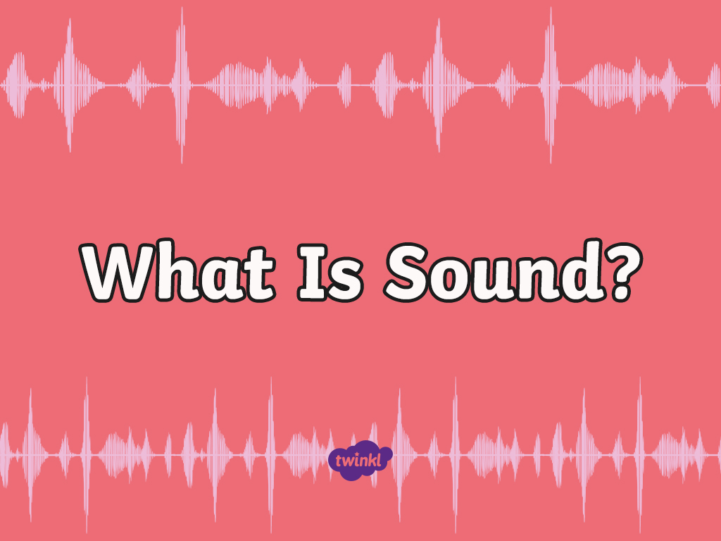

Slide 2
CfE Experiences and Outcomes
Through play, I have explored a variety of ways of making sounds.
SCN 0-11a
By collaborating in experiments on different ways of producing sound from vibrations, I can demonstrate how to change the pitch of the sound.
SCN 1-11a

Slide 3
What Is Sound?
Close your eyes and don’t make a sound.
What can you hear?
What direction is it coming from?
Is it loud or quiet?
Is it high pitched or a deep, low sound?
Do you like the sound?

Slide 4
Dancing Rice
Put some grains of rice on a drum and gently strike the drum.
What happens? Why?
The vibrations from the drum cause the rice to dance around.
It is these vibrations that let us hear the sound of the drum.

Slide 5
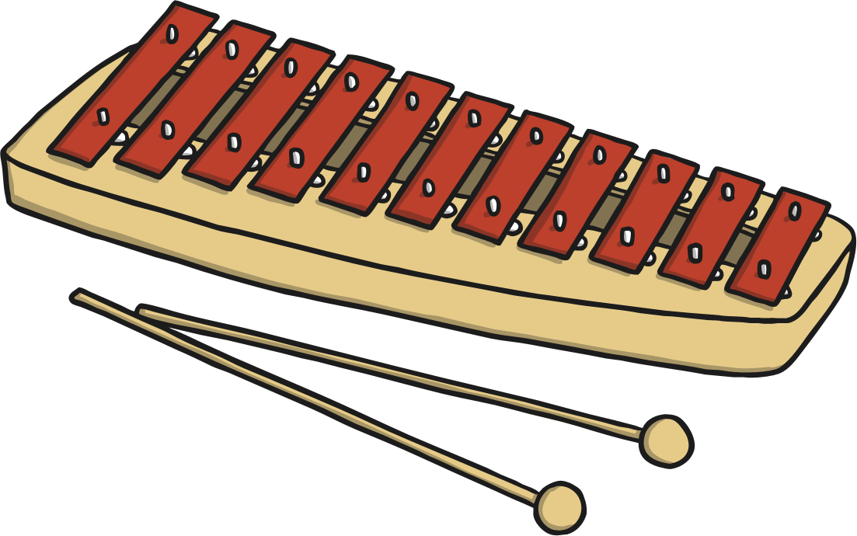
Vibrations
Sound is made when an object vibrates.
Press your fingers to your throat and talk to a friend. Can you feel the vibrations in your throat?
Strike a tuning fork or percussion instrument and then touch it gently with your finger. Can you feel it vibrating?

Slide 6
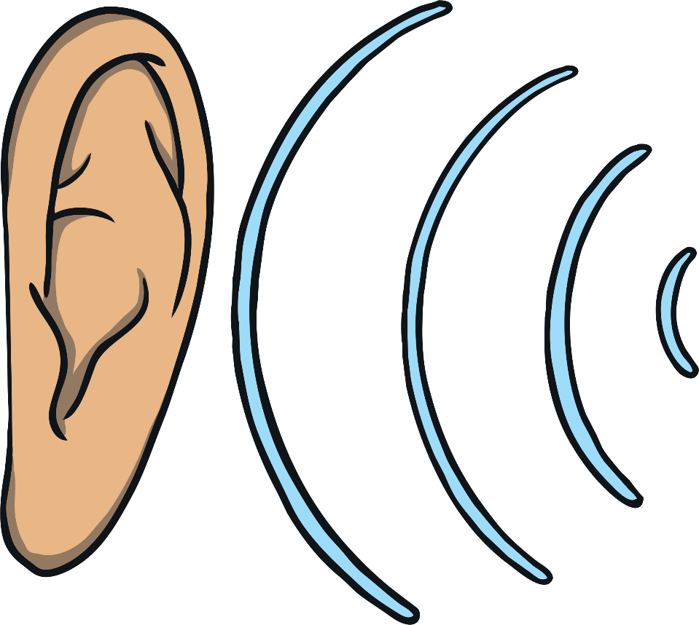
Vibrations
These vibrations travel through the air until they reach our ears. These travelling vibrations are called sound waves.

Slide 7
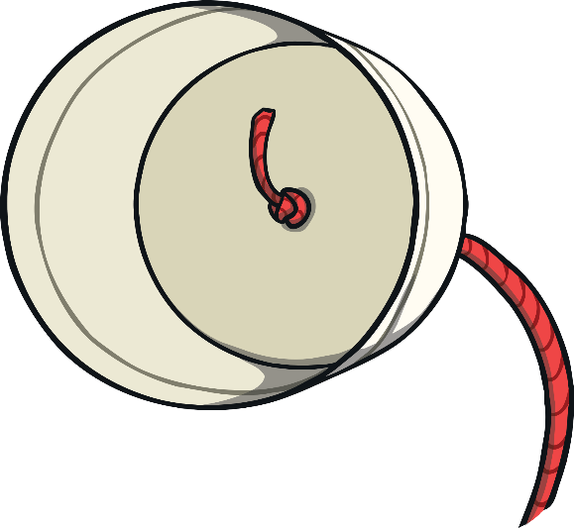
String Telephone
You can experiment with sound waves by making your own telephone.
Connect two plastic cups with a length of string.
Experiment with the length of string to see if you can still hear the sounds.

Slide 8
